Slide 1
Book Drive
NAME OF CHRISTIAN SCHOOL

Slide 2
School vision, mission, and/or pertinent operational details
You can help support
SCHOOL NAME

Slide 3
But he answered and said, It is written, Man shall not live by bread alone, but by every word that proceedeth out of the mouth of God.
-Matthew 4:4
You can help support
SCHOOL NAME

Slide 4
A biblical worldview is presented in all subject areas, for all ages, throughout the Portals curriculum. No matter what discipline, all Truth, wisdom, and understanding starts with scripture.
You can help support
SCHOOL NAME

Slide 5
Your gently used books are a blessing to the next generation of readers looking to learn more about God through His Word, and through other great literature.
You can help support
SCHOOL NAME

Slide 6
Dates:
Drop off location:
You can help support
SCHOOL NAME
If you have any questions, please contact NAME at PHONE NUMBER.

Slide 7
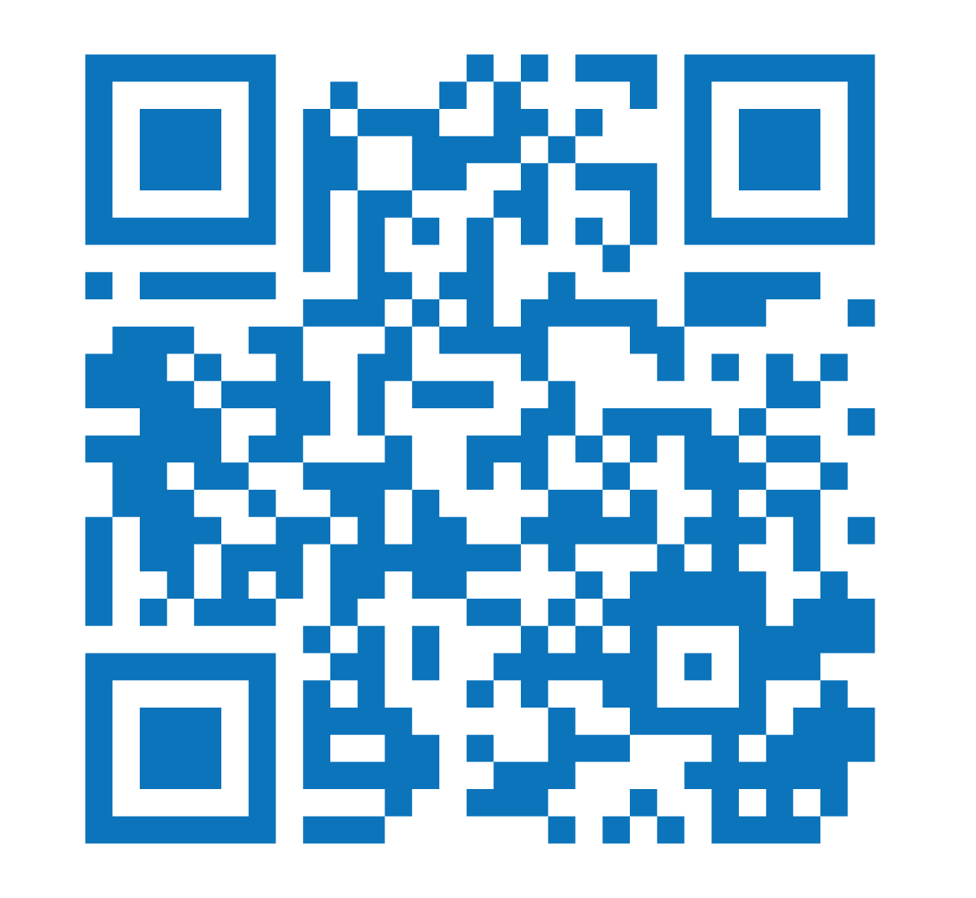
Book Lists
You can help support
SCHOOL NAME
*Print copies are available at LOCATION

